Slide 1
The MoJ Consultation (2): Transforming Legal Aid
#LCCSADrive – 08/10/14
Greg Powell
Powell Spencer & Partners (@PSPLawUK)

Slide 2
Its Politics not Money (Austerity)
Corporate welfare costs tax payers £85 billion per year.
This includes nearly £5 billion spent by the Department for Business on marketing, business coaching and advocacy services (The Guardian, 7 October 2014).
The MoD overspends £6.5 billion on equipment with major orders likely to be delivered near 40 years late (Sky New, January 2013)
NHS Budget for 2012/13 was around £109 billion (NHS website)
Total gross expenditure of Camden Council exceeded £1 billion in 2012/13 which is more than the entire criminal legal aid expenditure for England and Wales (Camden Council Budget Book)

Slide 3
Objectives of the Ministry of Justice
“That all those who provide criminal legal aid services could continue to do so”
“That the proposals deliver the necessary savings to the public purse”
Comment on KPMG assumptions
“That a limited number of duty contracts will deliver a long term and sustainable way forward”
Note “the dual contracting model and the decision to limit the number of contracts are not within the scope of the consultation”
The market to be competitive in future tendering rounds
What does the MoJ want? Information from legal aid practitioners relevant to the research analysis so that ministers can decide on the number of contracts to be offered.
Specifically comment on Otterburn pages 5 – 8

Slide 4
Otterburn Report: Pages 5 - 8
Principal Findings
A 5% average net profit margin, lower for larger firms
Firms have already reduced overheads
The supplier base is fragile
Cuts would have a disproportionate effect in London and the South East
Fee reduction should not take place before consolidation as this makes it more difficult to restructure
Contracts of £1.1m for police stations, magistrates court and crown court litigation to enable a viable practice in London
Good small firms may be excluded and large suppliers may contract
MoJ should take a different approach in rural areas
Management skills are limited
Financial constraints to growth
Few firms would survive the loss of duty work

Slide 5
Number of Providers 2007/8 – 2013/14

Slide 6
Criminal Legal Aid spend 2007/8 – 2013/14
£ (billions)

Slide 7
The Public Purse
23.4% reduction since 2008/09
No one knows the target spend, it may be £865 million
Does this scheme in itself reduce expenditure?
It actually adds substantial expenditure for both the Legal Aid Agency in tendering and administrative costs and to the providers

Slide 8
Assumption 1: Work volumes remain constant at 2012/13 levels – is this true?

Slide 9
Assumption 1: Work volumes remain constant at 2012/13 levels
The outcome for 2013/14 looks like 360 million reflecting the scale of cuts and falling volumes.

Slide 10
Assumption 1: Work volumes remain constant at 2012/13 levels

Slide 11
Assumption 1: Work volumes remain constant at 2012/13 levels
The trend appears similar to 2012/13 and substantially less than 2013/14

Slide 12
Assumption 1: Work volumes remain constant at 2012/13 levels
This trend appears severely downwards

Slide 13
Assumption 1: Work volumes remain constant at 2012/13 levels

Slide 14
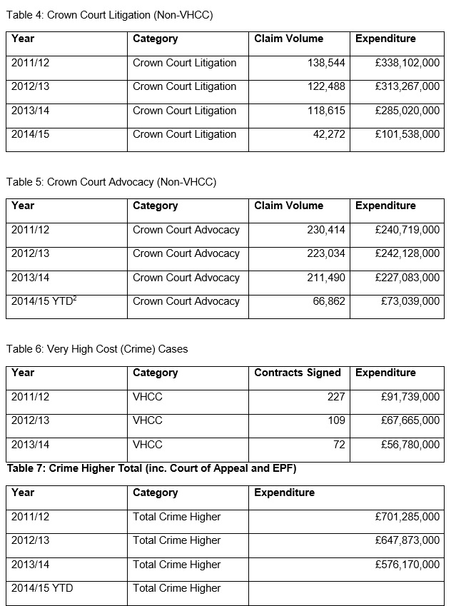
The trend from 2012/13 was downwards but it is a more mixed picture which reflects possibly the transfer of work between VHCC and Crown Court and a trend for Magistrates’ to decline jurisdiction?
In summary the MoJ assumption that work volumes remains constant is not evidenced by the figures.

Slide 15
“KPMG following discussions with the MoJ and TLS, and based on expert knowledge of the behaviour of markets made a number of modelling assumptions as to how providers would be likely to behave in the future.”

Slide 16
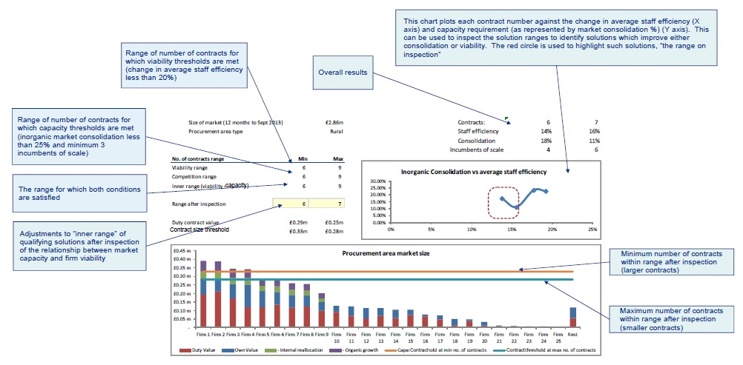

Slide 17
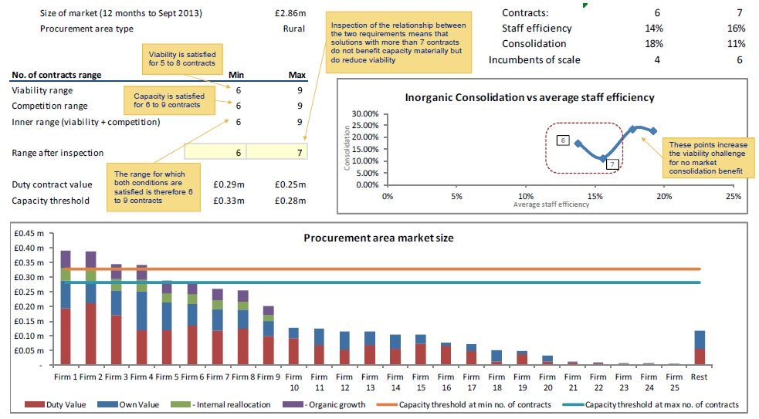

Slide 18
Assumption 2: Providers would on average be prepared to give up up-to 50% of their own client work in order to meet larger duty provider contract volumes.

Slide 19
Assumption 3: That positive profitability would be sufficient to ensure viability for providers

Slide 20
Assumption 4: 15% latent capacity exists within providers who may also re-allocate staff to work on criminal legal aid

Slide 21
Assumption 5: Providers have capacity for 20% organic growth through recruitment

Slide 22
Assumption 6: That a threshold for market consolidation of 25% is reasonable and that there would be 4 new entrants per area

Slide 23
Consultation Questions
Do you have any comments on the findings of the Otterburn report, including the observations set out at pages 5 to 8 of his Report?
Do you have any comments on the assumptions adopted by KPMG?
Do you have any comments on the analysis produced by KPMG?
Do you have any views on the MoJ comments set out in this document?
If the assumptions and data on which the KPMG recommendations are based remain appropriate, do you consider that there is any reason not to accept the maximum number of contract possible (525), as the MoJ have done?
Do you have any other views we should consider when deciding on the number of contracts?

Slide 24
Conclusions
Any rational evidence based risk/cost benefit analysis would conclude that the scheme will not meet the objectives of;
That all firms will continue in business
That there will be long term stability
That there will be sufficient firms for future competition
The KPMG assumptions are not based on our reality and I have asked my professional body to commission an independent report to better inform me and the MoJ before a scheme which carries huge risks is implemented.
Tell them?
I will not surrender any own client work
I do not have latent capacity
I do not have a basis to organically grow given the low margins and cuts
I do not have staff to redeploy
Finally the risks and costs are so high if the scheme proceeds I will not bid?

